Slide 1
Welcome to Online Blood Bank Management System
This online Blood Bank management system project
Directed by: Shantonu Roy (B.Sc in CSE)
Submitted by: ABDUR RAHIM
(Roll:372695, 5/CMT/A₂ )

Slide 2
Acknowledgements
It is my pleasure to be indebted to various people, who directly or indirectly contributed in the development of this work and who influenced our thinking, behavior, and acts during the course of our training. I express my sincere gratitude Shantonu Roy(B.Sc in CSE)worthy mentor, guide and a great teacher who influenced and inspired me in many ways. Lastly, I would like to thank the almighty and my parents for their moral support and my friends with whom I shared our day-to-day experience and received lots of suggestions that improved our quality of work.

Slide 3
Project Introduction
The BLOOD BANK MANAGEMENT SYSTEM is great project. this project is designed for successful completion of project on blood bank management system. the basic building aim is to provide blood donation service to the city recently. Blood Bank Management System (BBMS) is a browser based system that is designed to store, process, retrieve and analyze information concerned with the administrative and inventory management within a blood bank. Aim is to provide transparency in this field, make the process of obtaining blood from a blood bank hassle free and corruption free and make the system of blood bank management effective.

Slide 4
Need of Blood Bank Management System
Bank blood donation system in java is planned to collect blood from many donators in short from various sources and distribute that blood to needy people who require blood. To do all this we require high quality software to manage those jobs. The government spending lot of money to develop high quality “Blood Bank management system project”. For do all those kinds of need blood bank management system project in java contain modules which are include the detail of following areas:
Blood Donor
Equipments
Stick
Blood Recipient
Blood collection
Stock details
blood bank system project Reports
Blood issued
Blood bank system project

Slide 5
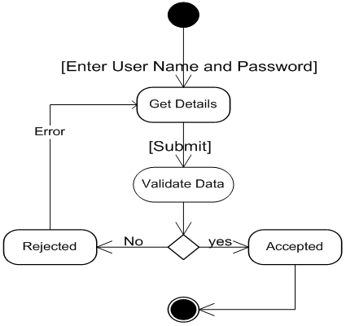
Complete DFD & E-R Diagrams
The entity-relationship data model is based on a perception of a real world that consists of a collection of basic objects called entities and of relationships among these objects. An entity is an “object” in the real world that is distinguishable from other objects. For e.g. each customer is an entity and rooms can be considered to be entities.
The logical structure of a database can be expressed graphically by an E- R diagram consists of the following major components:

Slide 6
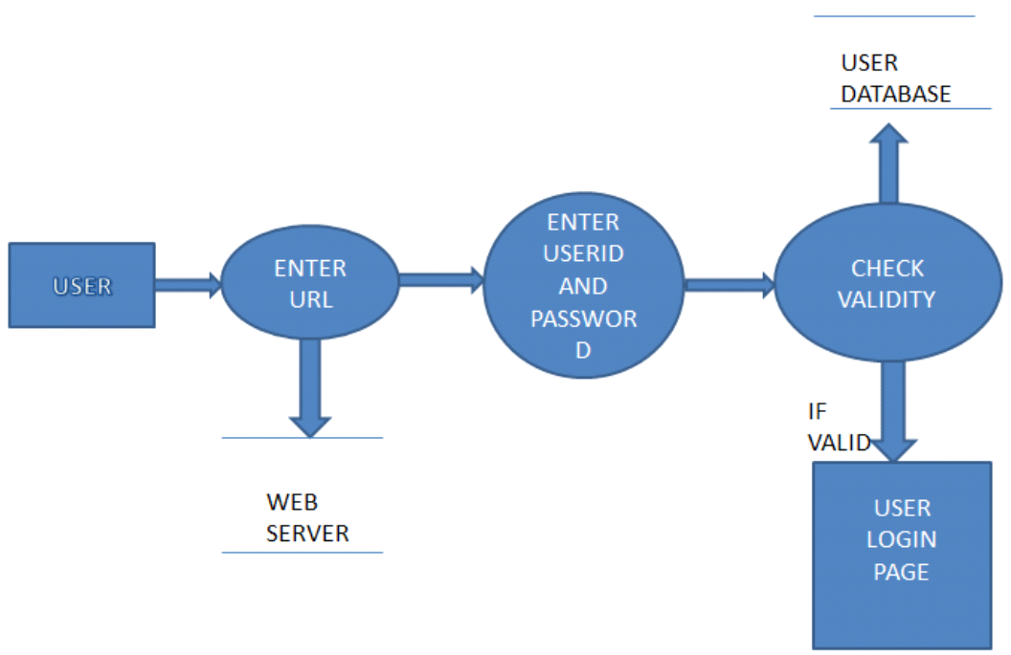
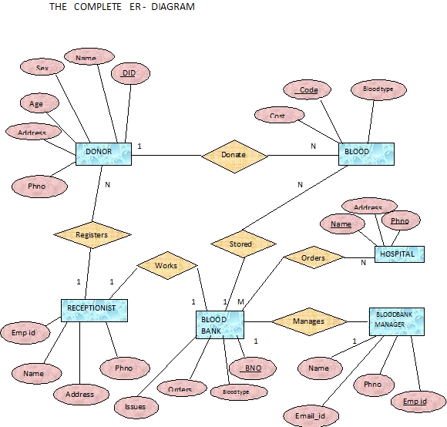
DFD FOR USER LOGIN
After entering to the home page of the website , student can choose the USER LOGIN option where they are asked to enter username & password , and if he/she is a valid user then a user login page will be displayed

Slide 7
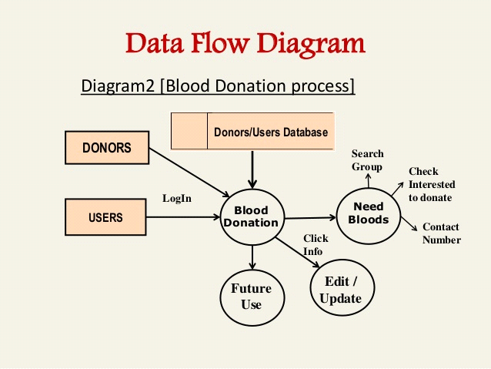
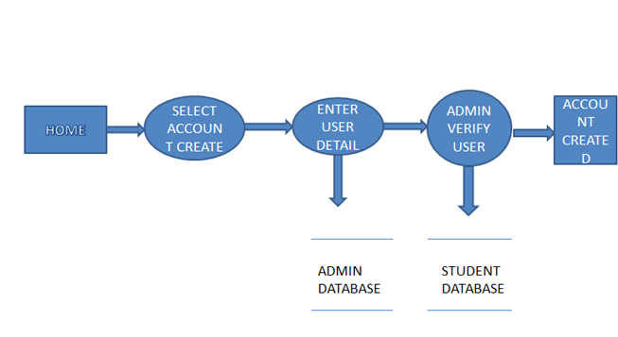
DFD FOR ACCOUNT CREATION:
After the home page login there will be an option of CREATE AN ACCOUNT where after entering user detail ,if all the fields are filled then a request will be sent to the librarian who will approve him as a registered member of the website.

Slide 8
Module Description
BLOOD DONATION is a website based on PHP. The purpose of this project was to develop a blood management information system to assist in the management of blood donor records and ease or control the distribution of blood in various part of country basing on the hospitals demand. . This project includes mainly two modules i.e. login and main page.
Login
Admin
User

Slide 9
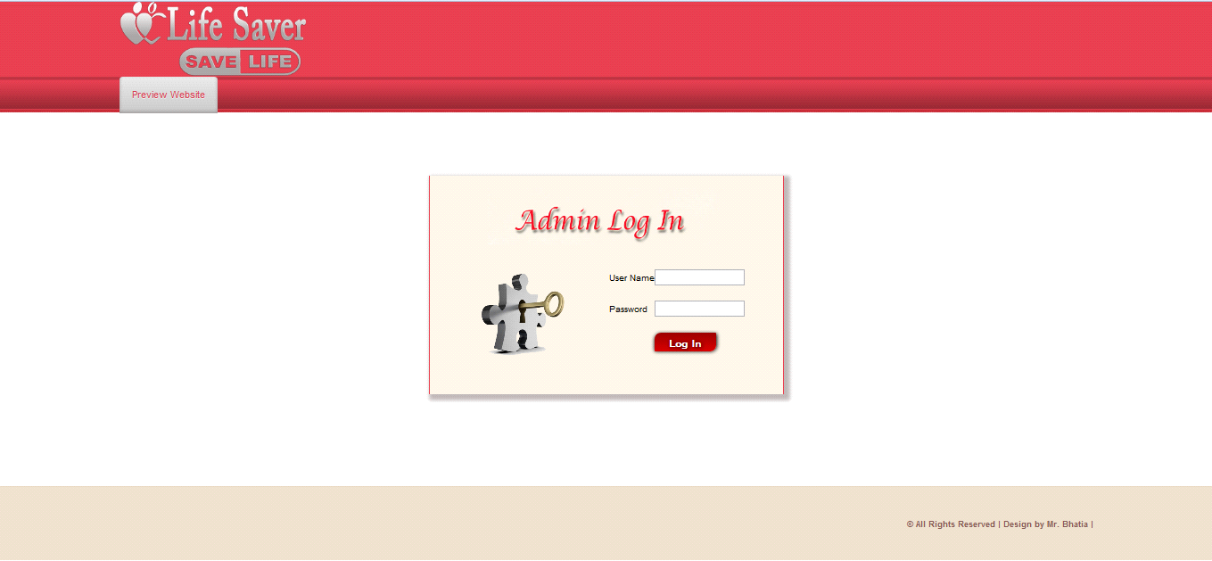
Admin: The page require user name and password to start the application. Login is a process by which individual access to a computer system is controlled by identifying and authenticating the user through the cardinalities presented by the user. Admin can add update or delete the user, city, state, camp etc.

Slide 10
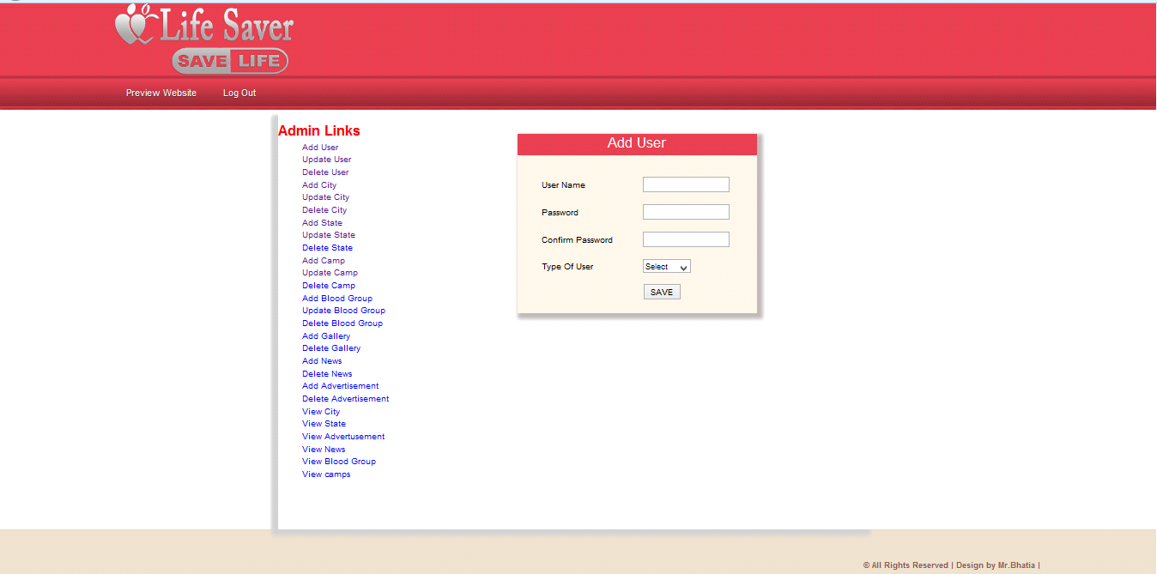
User: User can register the account by fill the information about you and click on save button. He/she can add the account for the further enquiry of the blood donation. The user have to login to get more information about the blood bank.

Slide 11
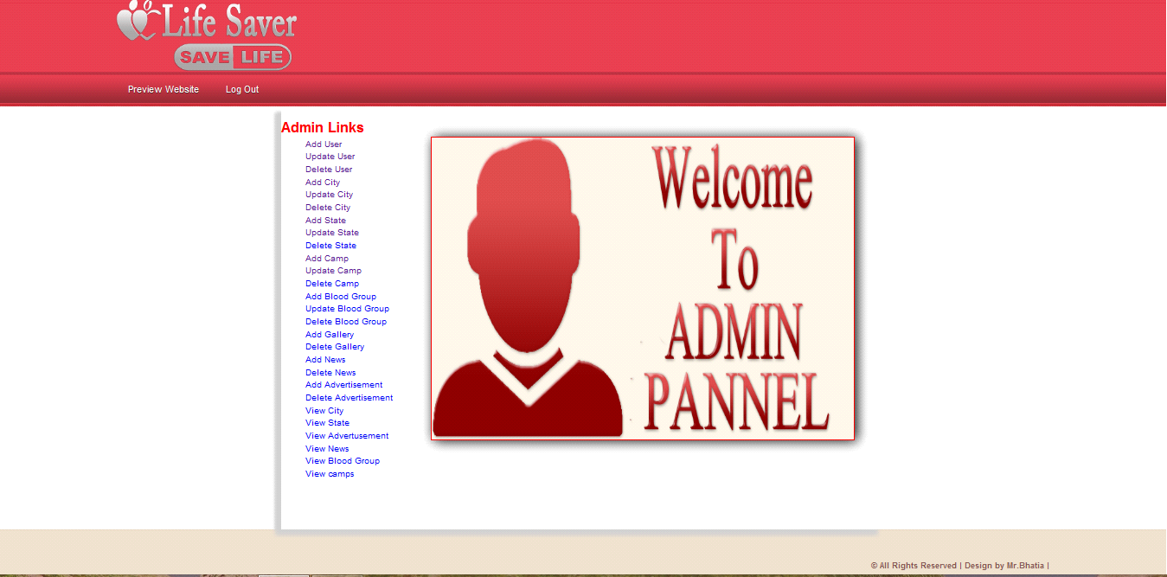
Admin are of a two type:
Admin level user
General level user
Admin level user:Admin level user are a admin user, if he/she login a admin panel they work on a all the pages of the admin site like add user, update user, delete user, add city, update city, delete city etc.

Slide 12
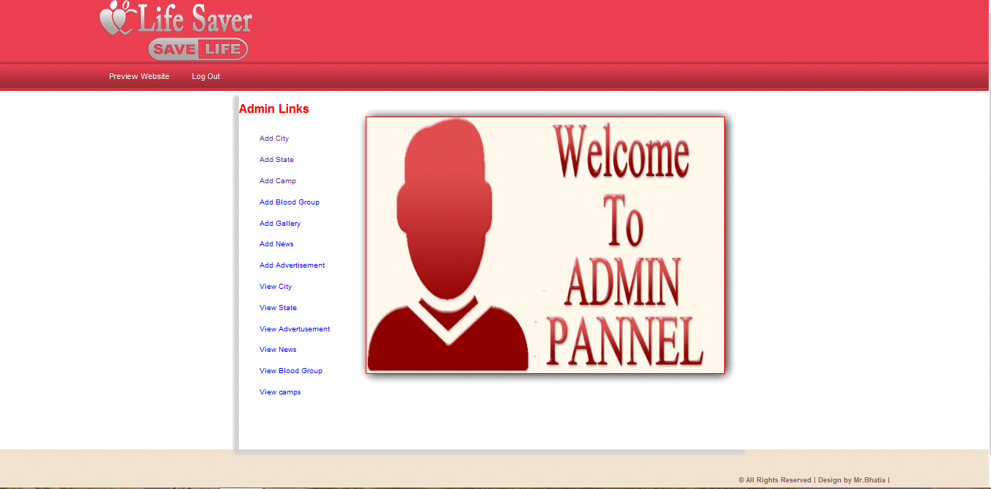
General level user :General level user are a general user, if he/she login a admin panel they don not see all the pages of the admin site like add user, update user, delete user, add city, update city, delete city etc. They work on only a addition of the new user, city, state, camp etc.

Slide 13
Main Page:
Main Window
Registration Page
Donor login
Main Window:- The BLOOD BANK MANAGEMENT SYSTEM is great project. this project is designed for successful completion of project on blood bank management system. the basic building aim is to provide blood donation service to the city recently. Blood Bank Management System (BBMS) is a browser based system that is designed to store, process, retrieve and analyze information concerned with the administrative and inventory management within a blood bank. This project aims at maintaining all the information pertaining to blood donors, different blood groups available in each blood bank and help them manage in a better way.

Slide 14
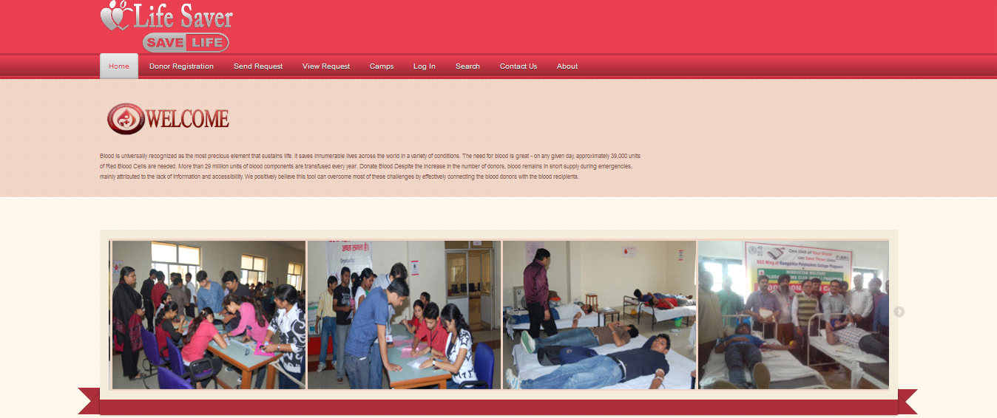
Home page:- This is the home page or the main page of a blood bank management system. This is the main page of a client side. This page define all about related to project. This page also includes the galary of the camps.

Slide 15
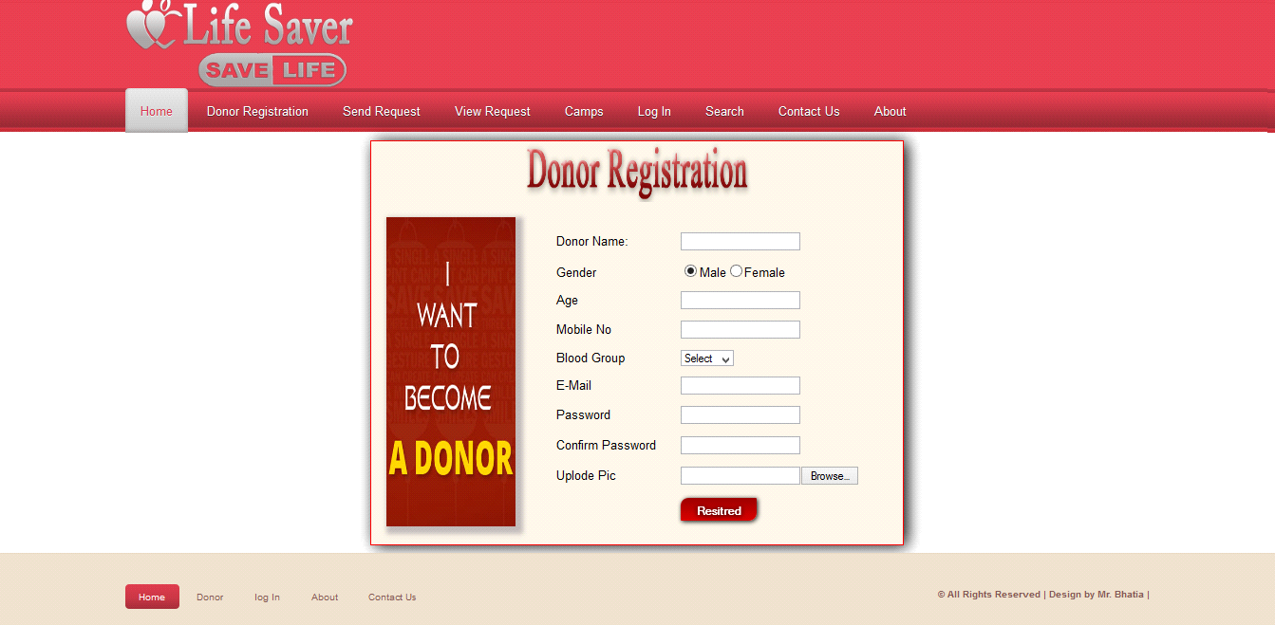
Registration: Registration page includes the information of the donor who want to register. Donor can register the account by clicking on new register. He/she can add the account for the further enquiry of the blood donation.

Slide 16
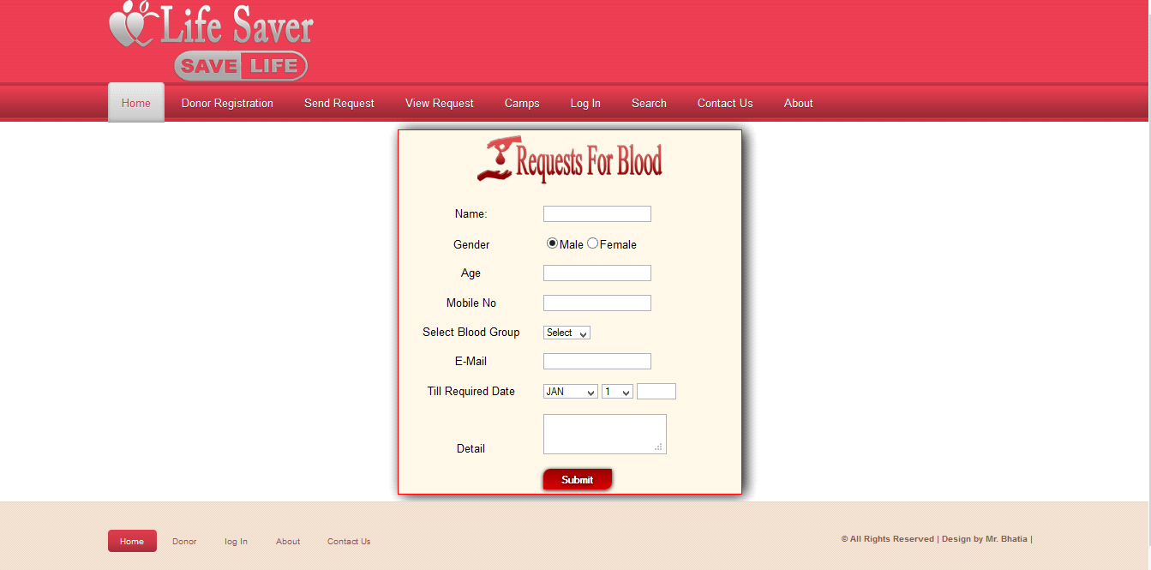
Request For Blood: Request for blood page includes the information of the donor who want to register. Donor can register the account by clicking on new register. He/she can send requests for the further enquiry of the blood donation.

Slide 17
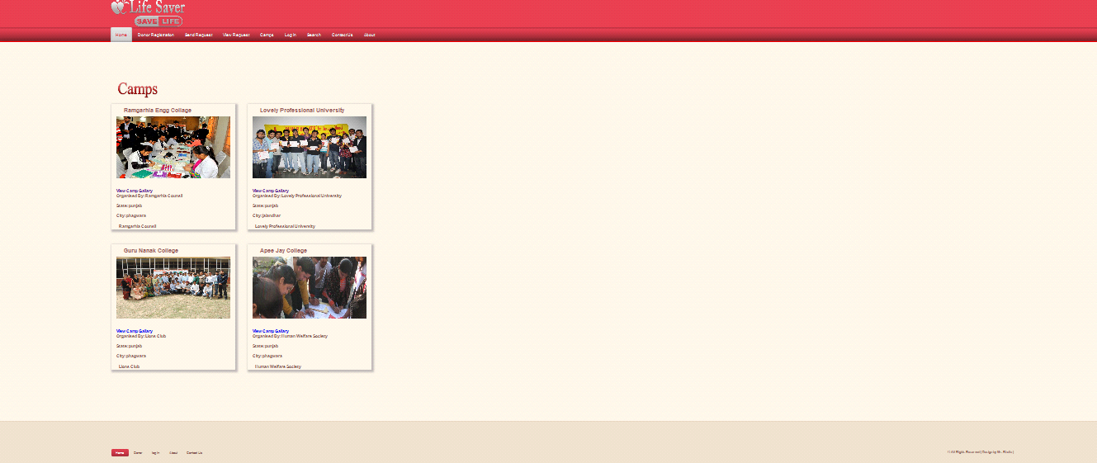
Camps:Camp page includes the information about camps, this camps organised the blood donation camp. Donor can register the account by clicking on new register. Request for blood page includes the information of the donor who want to register. Donor can register the account by clicking on new register. He/she can send requests for the further enquiry of the blood donation.

Slide 18
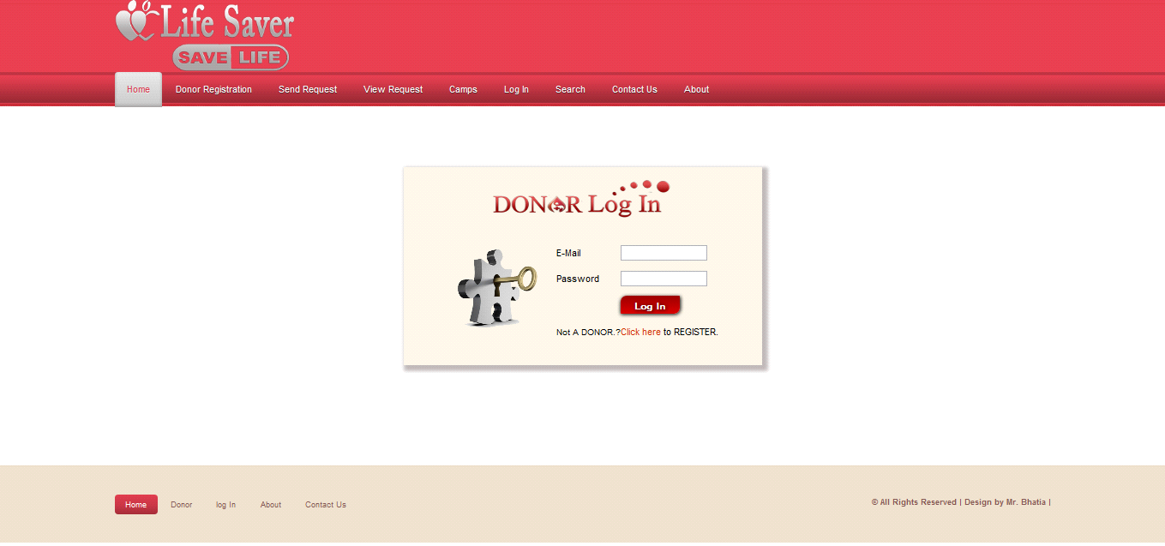
Donor Login :It is login menu, I have set a default E-mail and password for it. This mail id and password are store in a binary file inside this project. For Password security I have replace the password's alpha numeric character to special symbol,move to next menu otherwise it will show you error message and ask you to invalid mail id and password.

Slide 19
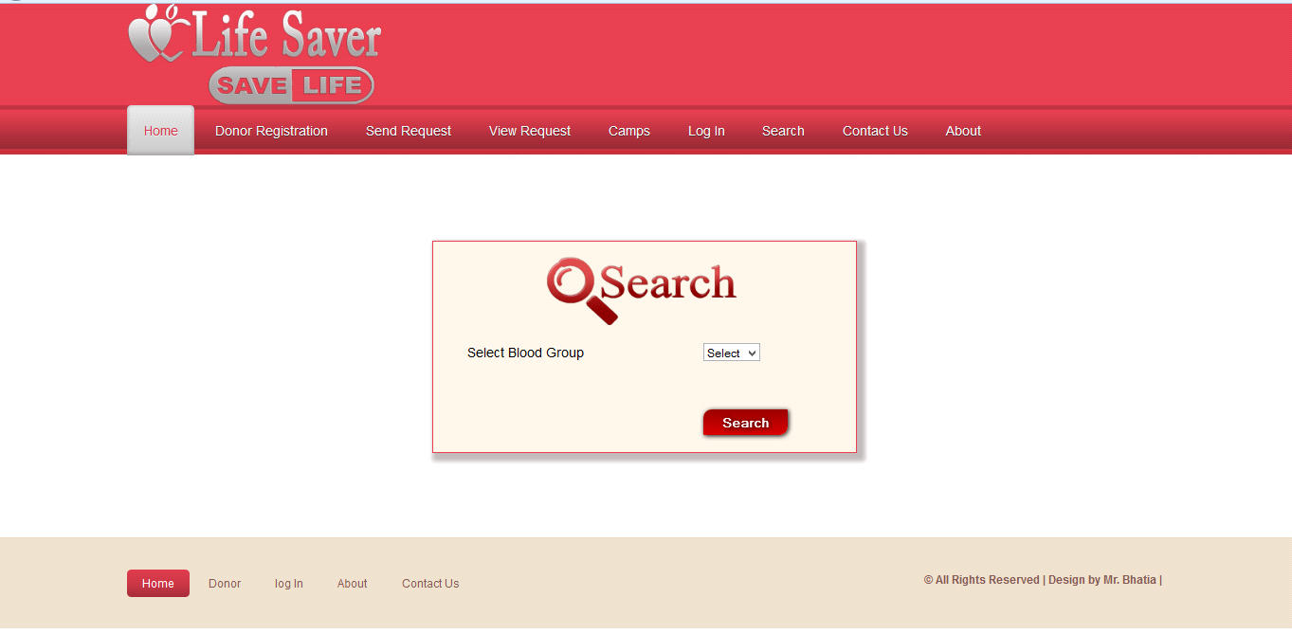
Search:Search button is used for search the donations of blood for a different defferent blood groups.Blood groups name
A
A+
B
B+
AB+
AB_
O+
O-

Slide 20
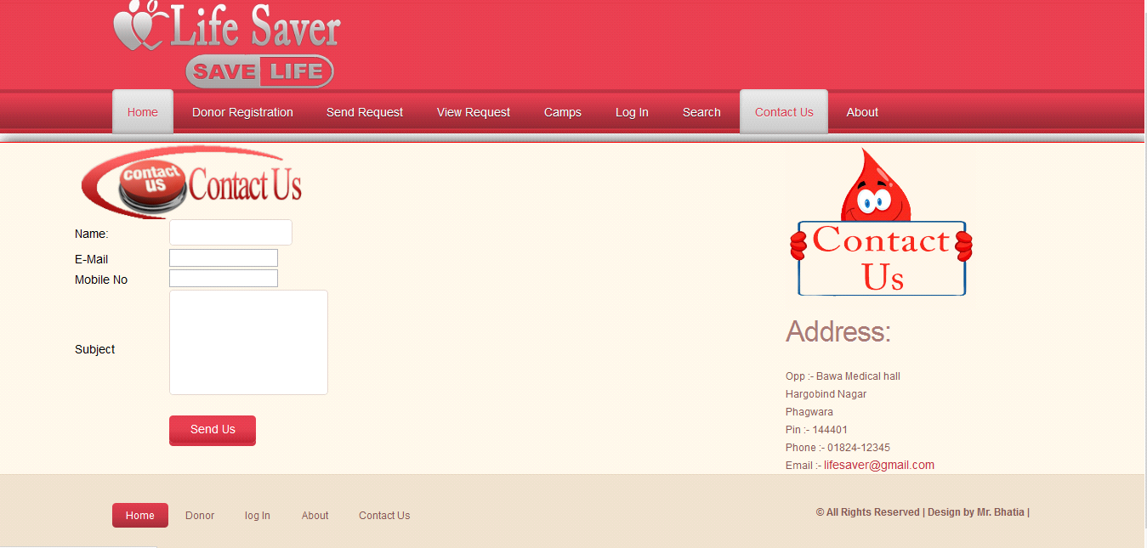
Contact:In contact page any one who wants to need a blood or gaining a information about this system then he/she can contact with us.Person will get the blood immediately he/she requested for the particular blood group he/she Has requested.

Slide 21
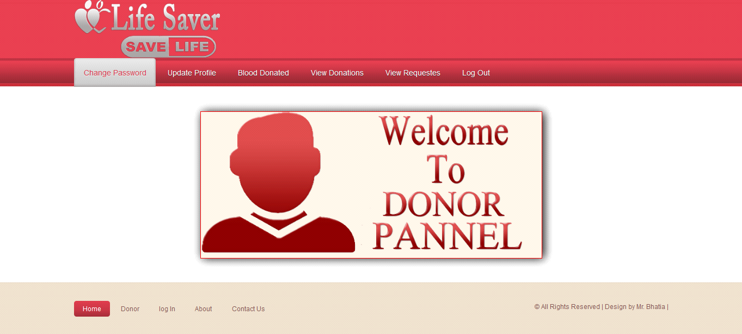
Donor Pannel:This page is the the welcome page of the donor panel. In this page include all the module related to Donor like :

Slide 22
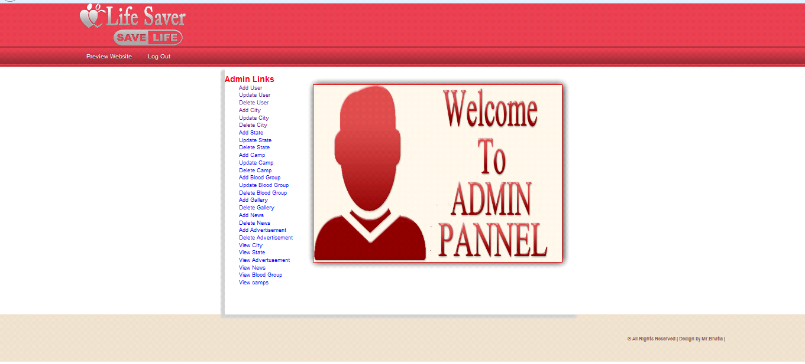
Admin Pannel:This is the admin side of the project, shows all the admin page like addition , updation, deletion of the user, city,state,camps etc.Person will get the blood immediately he/she requested for the particular blood group he/shehas requested.

Slide 23
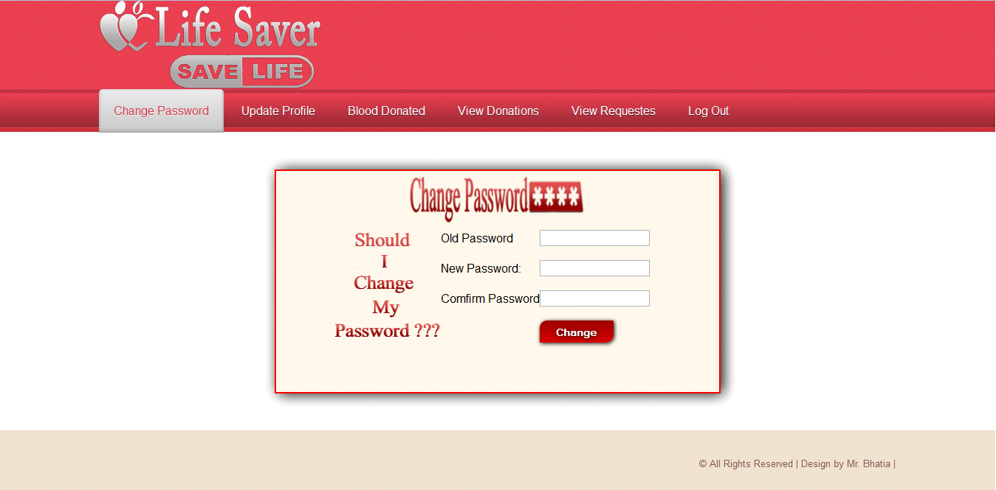
Change Password :Above snap short describe how the donor change our password .This is only used by a donor.

Slide 24
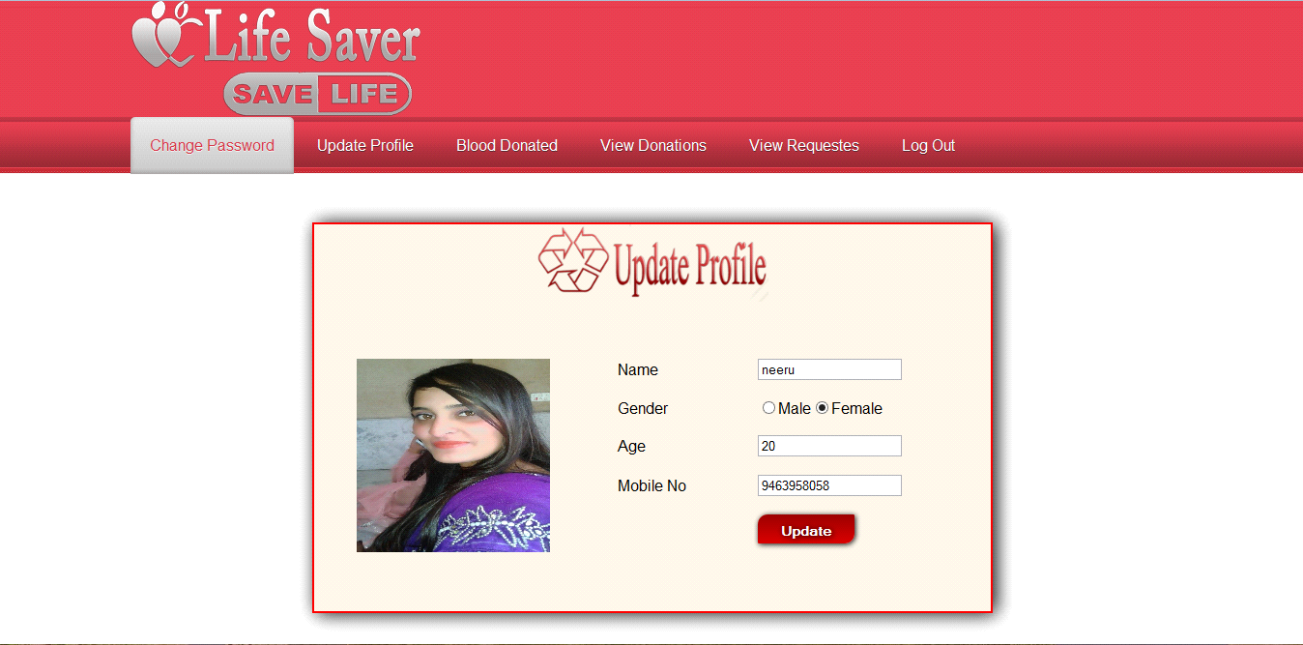
Update Profile
Above snap short describe how the donor update our profile .This is only used by a donor.

Slide 25
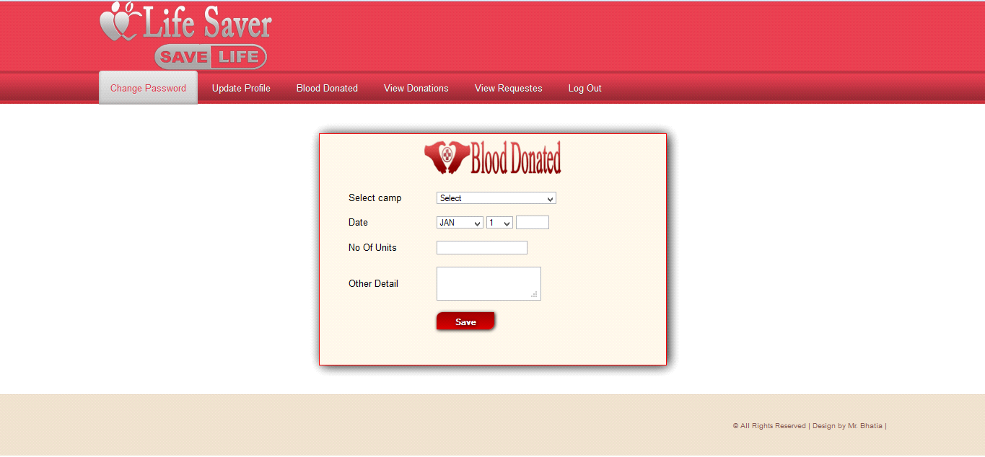
Blood Donated :Above snap short describe about donation from donor.This is only used by a donor.Person will get the blood immediately he/she requested for the particular blood group he/shehas requested.

Slide 26
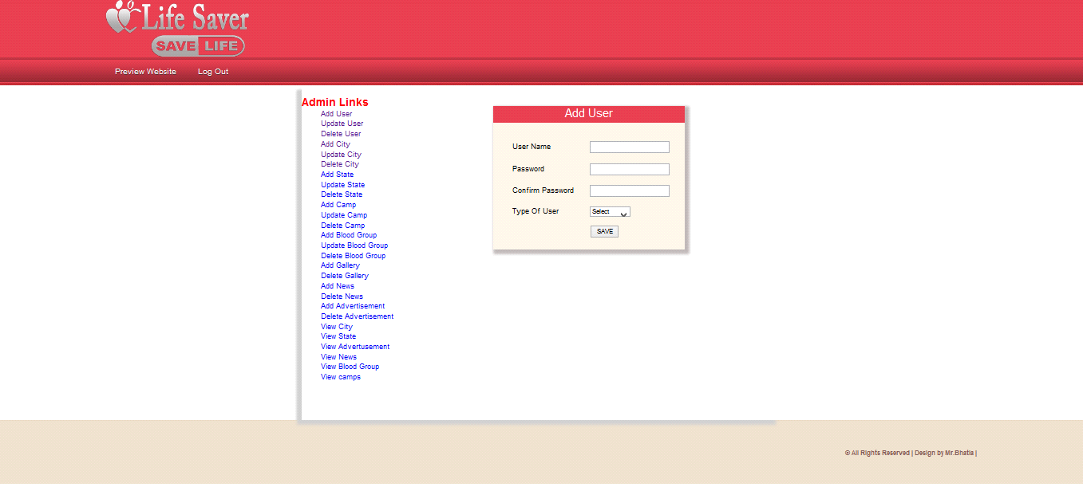
Add user :Show the addition of user.Person will get the blood immediately he/she requested for the particular blood group he/she has requested.

Slide 27

Update User:Show the updation of user.

Slide 28
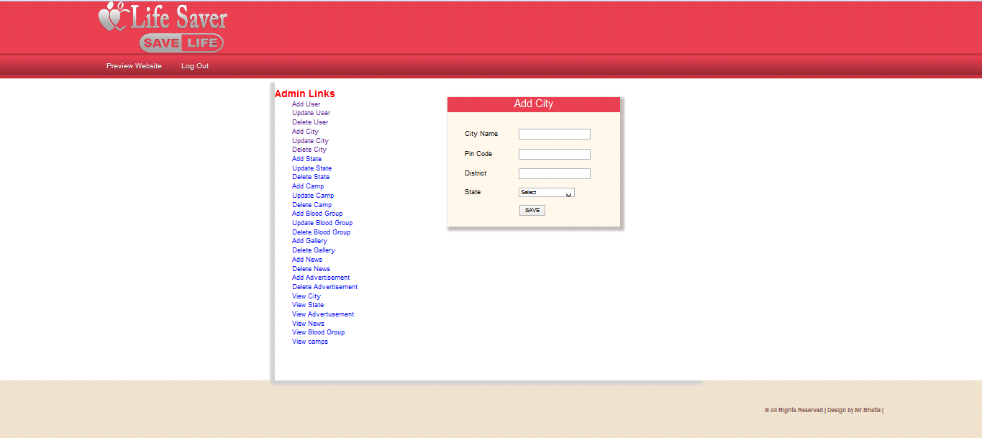
Add City:Show the addition of city.Person will get the blood immediately he/she requested for the particular blood group he/she has requested.

Slide 29

Update City:Show the updation of city.Person will get the blood immediately he/she requested for the particular blood group he/she has requested.

Slide 30

Add Camp:Show the addition of camp.Person will get the blood immediately he/she requested for the particular blood group he/she has requested.

Slide 31
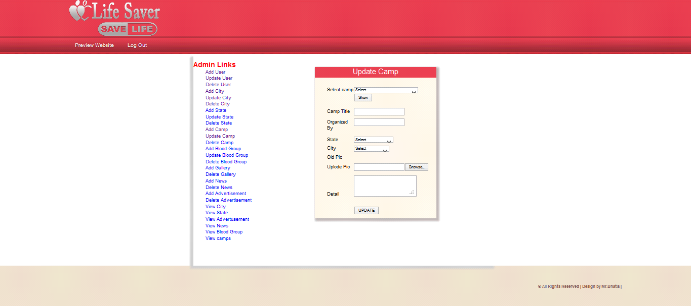
Update Camp:Show the updation of camp.Person will get the blood immediately he/she requested for the particular blood group he/she has requested.

Slide 32
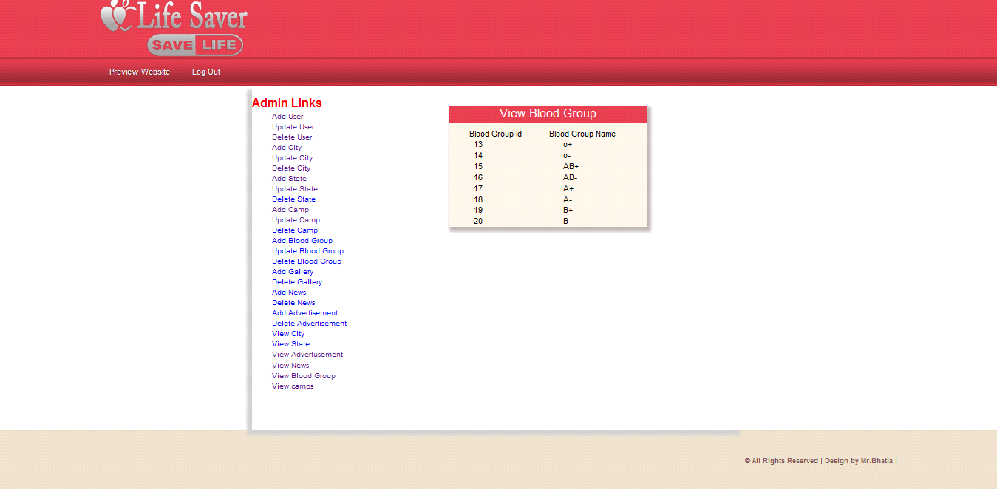
View Blood Group:This snapshort shows all the blood group. This shows blood group name and id.Person will get the blood immediately he/she requested for the particular blood group he/she has requested.

Slide 33
Summary and Conclusion:With the theoretical inclination of our syllabus it becomes very essential to take the atmost advantage of any opportunity of gaining practical experience that comes along. The building blocks of this Major Project ”BLOOD BANK Management System” was one of these opportunities. It gave us the requisite practical knowledge to supplement the already taught theoretical concepts thus making us more
competent as a computer engineer. The project from a personal point of view also helped us in understanding the following aspects of project development:
The planning that goes into implementing a project.
The importance of proper planning and an organized methodology.
The key element of team spirit and co-ordination in a successful project.
The project also provided us the opportunity of interacting with our teachers and to gain from their best experience

Slide 34


